Slide 1
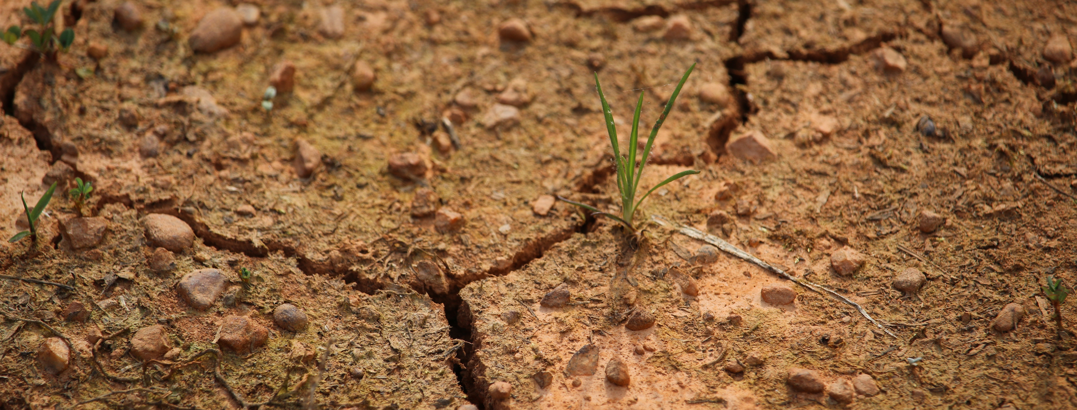
Project Nighthawk

Slide 2
Project Background: Goals
Connect decision makers in agriculture, forestry, and water resources sectors to information by making that information more accessible, rather than creating new information or data.

Slide 3
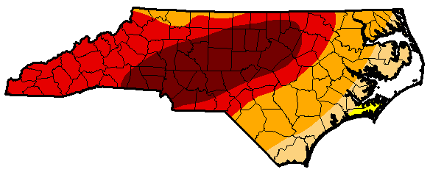
Project Motivation

Slide 4

Project Motivation
?
?
?

Slide 5
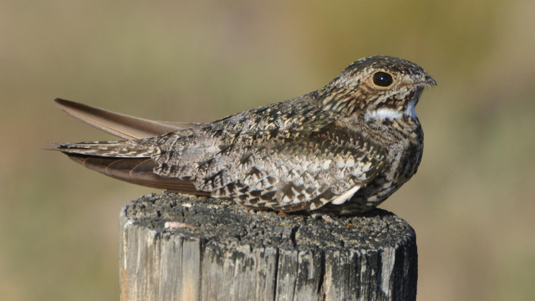
Project Background
Official Title: “Innovating Approaches to Drought Communications with North Carolina Decision Makers”
Code Name: Project Nighthawk
Project Team: Corey Davis
(SCONC), Kirsten Lackstrom (CISA)
The common nighthawk. Photo by Andy Reago and Chrissy McClarren, shared under CC BY 2.0.

Slide 6
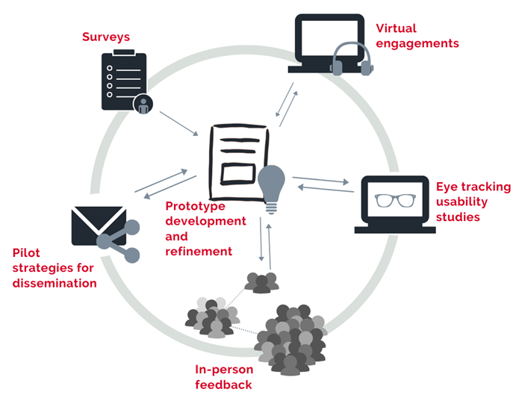
Our Process

Slide 7
Communication Priorities
* 1) Infographics to accompany the weekly drought map
* 2) Short-range outlooks for the next month
3) Summaries of state- or basinwide conditions
* 4) Background information about the drought monitoring process and the NC DMAC
* = new resources developed through the project

Slide 8
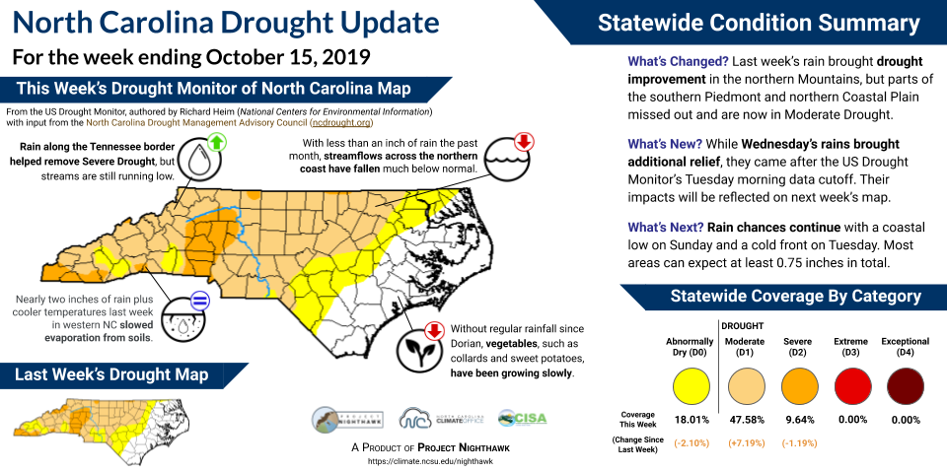
Notes:
Weekly drought update infographic

Slide 9
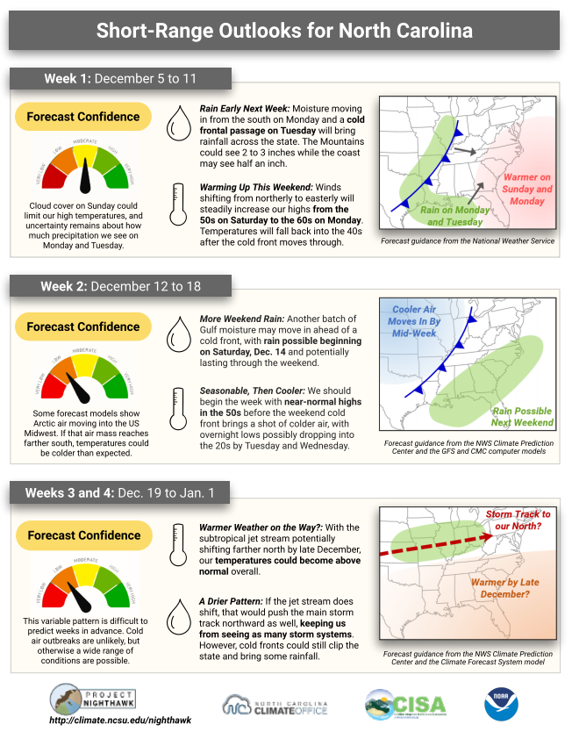
Notes:
Short range outlook infographic

Slide 10
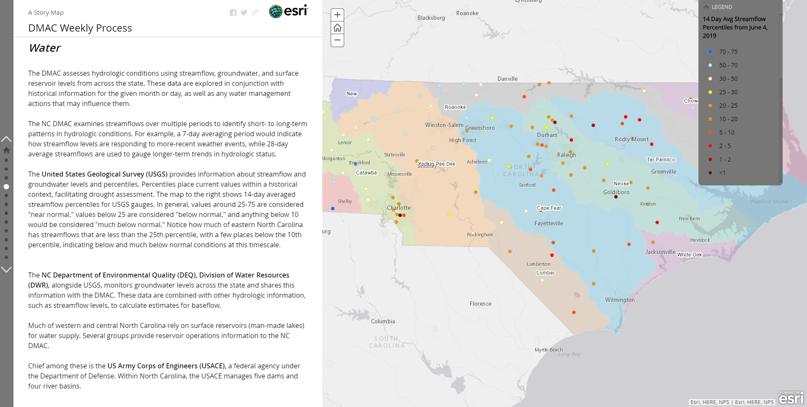
Story map describing NC DMAC and weekly process.
Ideas for content and layout of ncdrought.org website
Notes:
Updated and story map to NC DMAC website

Slide 11
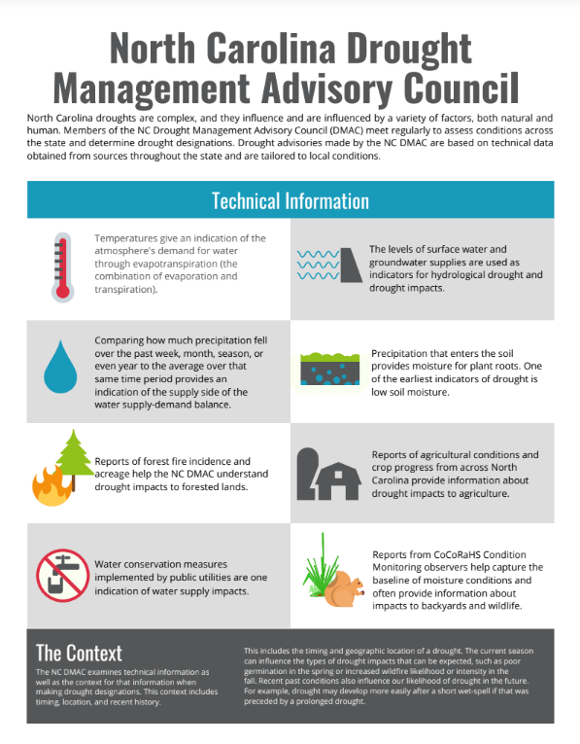
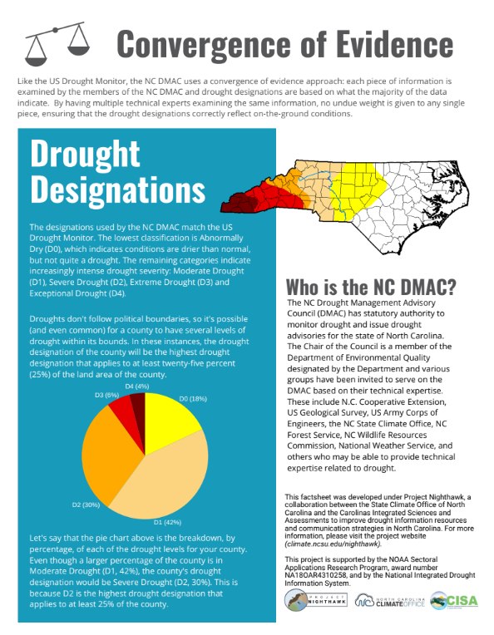
Notes:
Handouts about the NC DMAC

Slide 12
Communication Priorities
* 1) Infographics to accompany the weekly drought map
* 2) Short-range outlooks for the next month
3) Summaries of state- or basinwide conditions
* 4) Background information about the drought monitoring process and the NC DMAC
* = new resources developed through the project

Slide 13
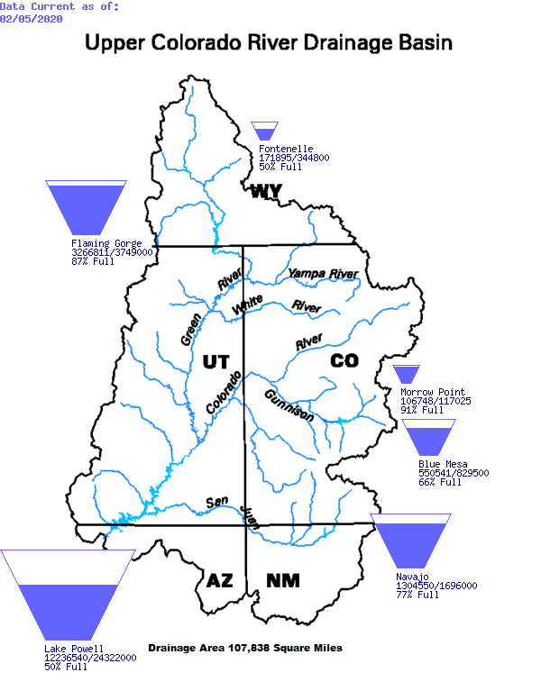
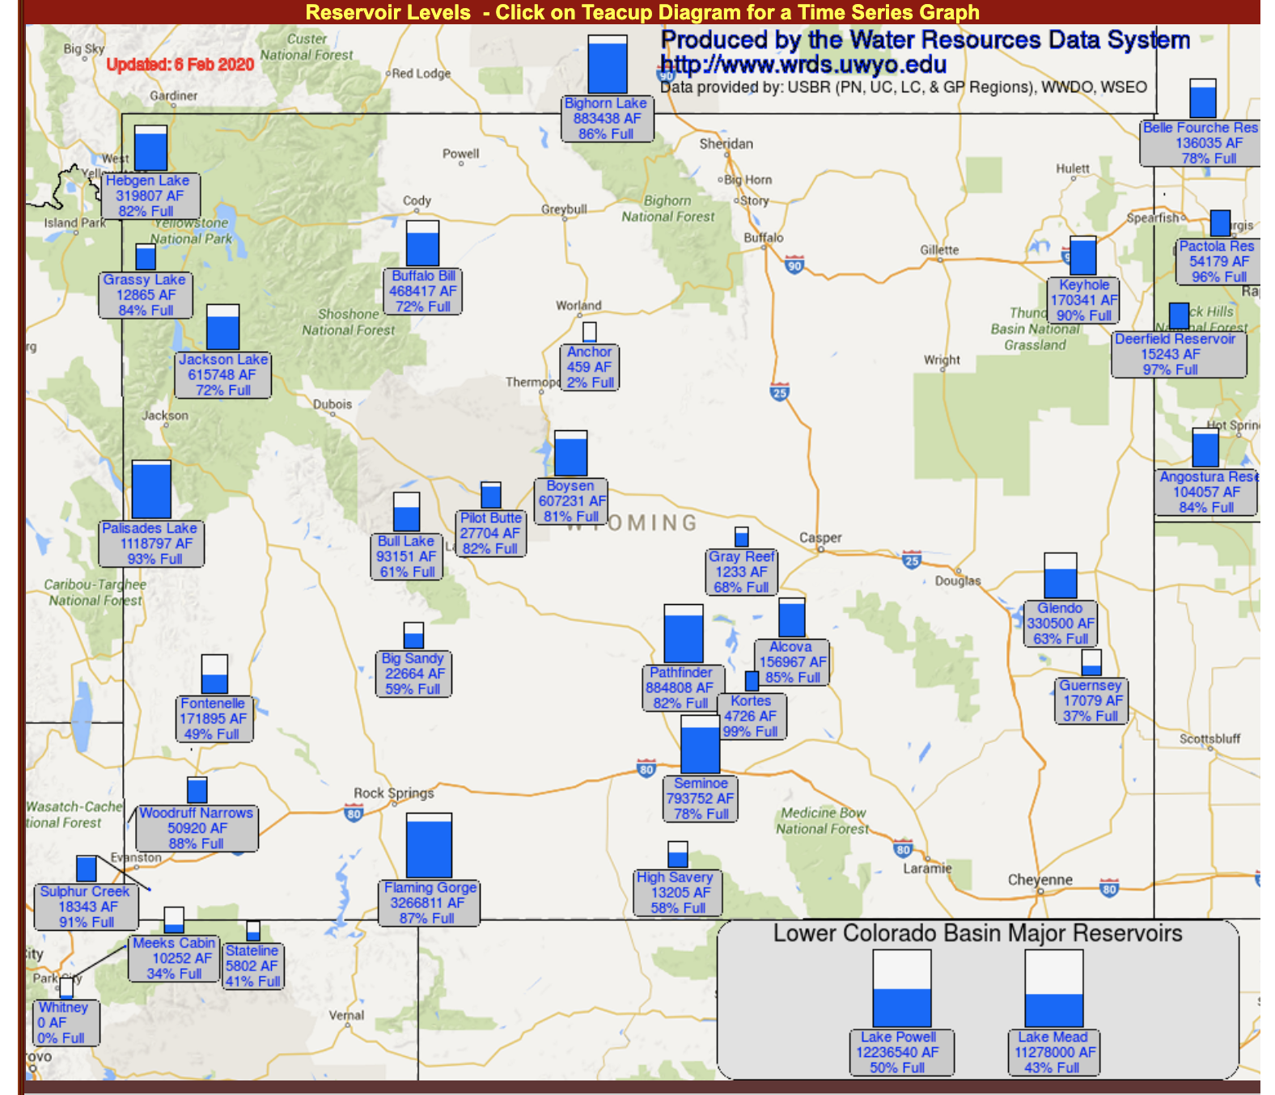
Aggregating Conditions State/Basinwide
Existing resources (e.g., Integrated Water Portal) for:
data exploration,
technical users,
only include government data
Some examples from western US →

Slide 14
Aggregating Conditions State/Basinwide
Collaboration with NC State University graduate-level design course
Assignment: design mock-ups for portal to convey complexity of drought-related information

Slide 15
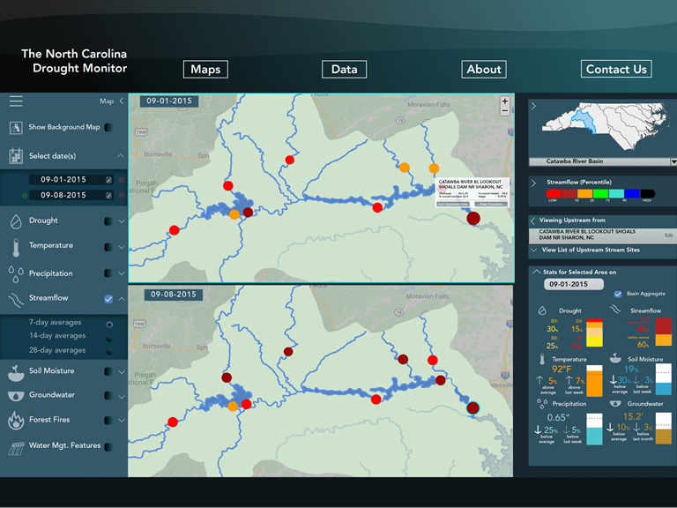
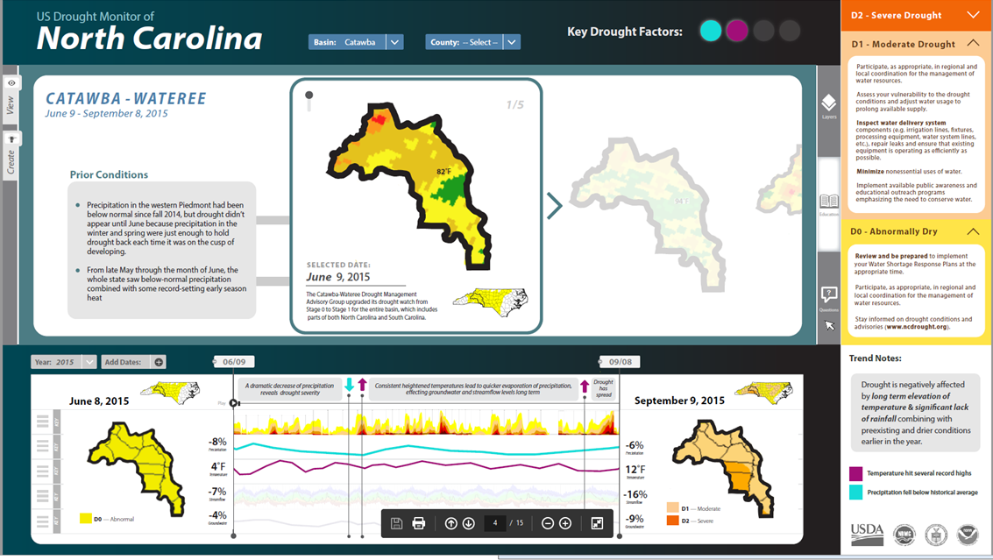
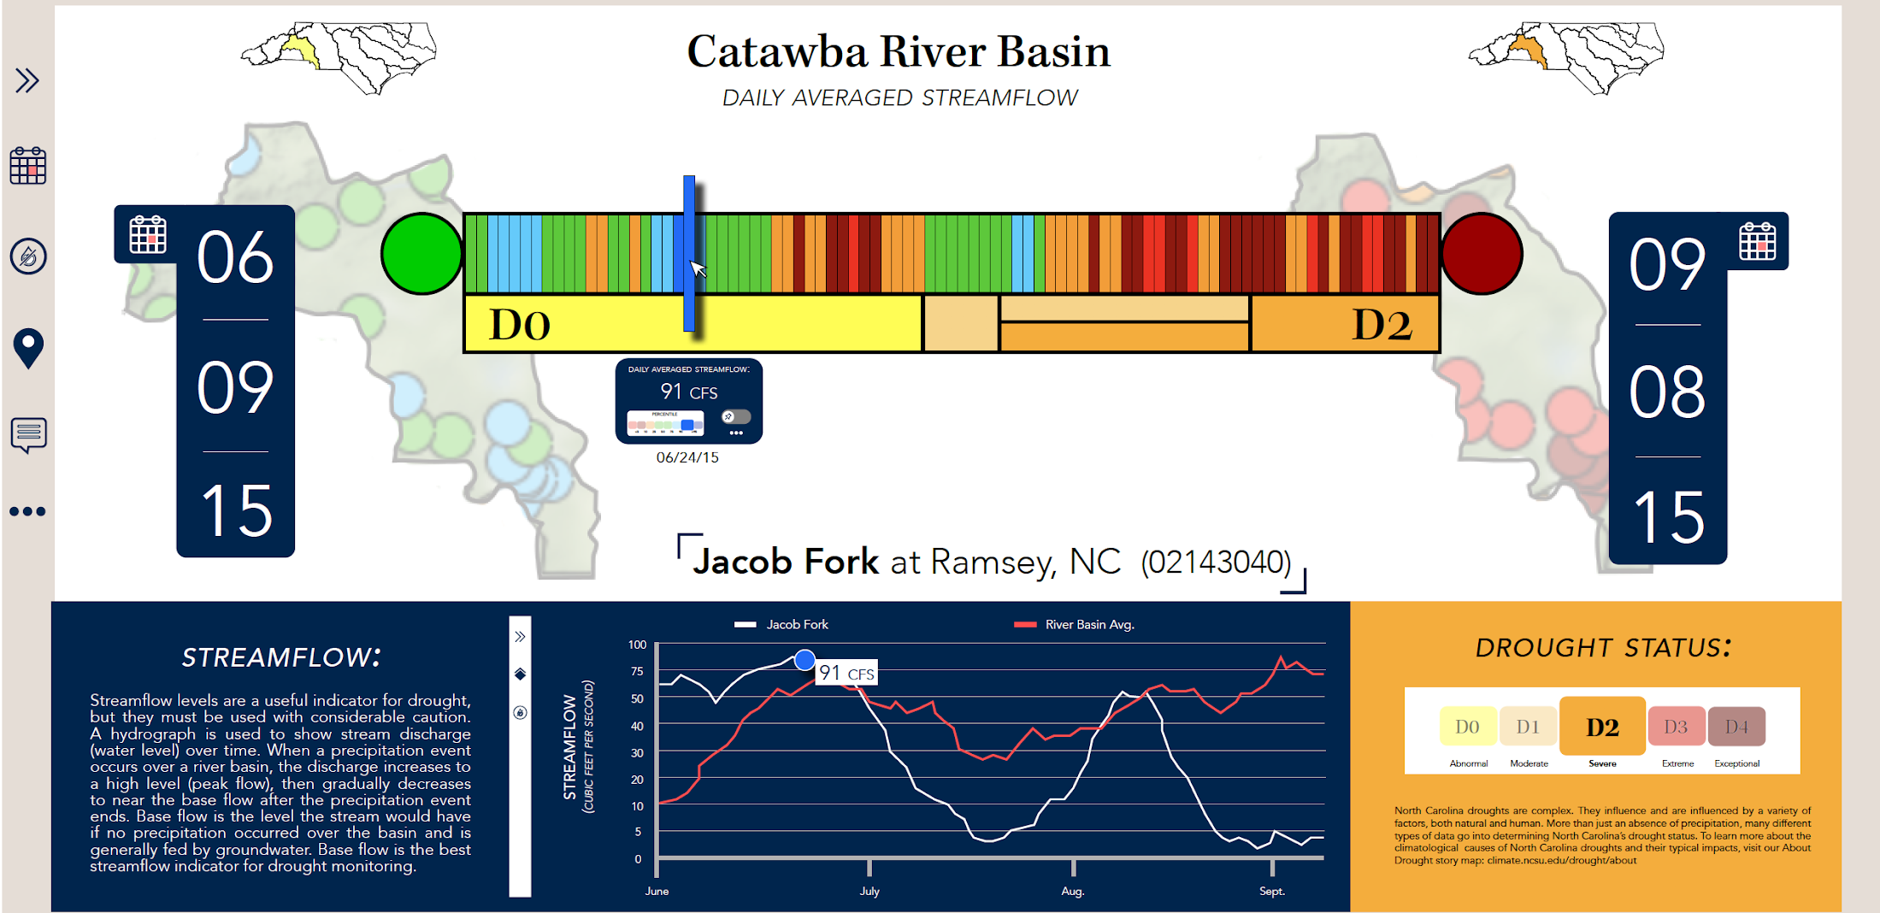
Design by student Casey Stanek
Design by student Lauren Burnham
Design by student Phil Oweida

Slide 16
Internet of Water
Focus:
Facilitating the opening, sharing, and integration of water data and information
https://internetofwater.org/

